Slide 1
JAVA PROGRAMMING PROJECT
HOTEL BOOKING &
OCCUPANCY MANAGER
Java Programming Project
Project Members: Bharadwaj · Mukesh

Slide 2
PROJECT OVERVIEW
Abstract
A Java-based application for managing hotel room bookings from customer details through booking cost and customer categorization.
Capture
Choose
Validate
Demonstrate
Accepts customer and booking details
Standard, Deluxe, and Suite room choices
Validates booking information and calculates cost
Methods, arrays, recursion, searching, counting, and matrix operations
02

Slide 3
THE NEED
Problem Statement
Manual room booking is difficult to track and easy to miscalculate. The application turns a booking request into a validated result.
1
2
3
4
5
Customer
Booking details
Validation
Calculation
Booking result
Name, room type, rooms, days
Check room, room-count, and day inputs
Calculate booking amount
Process with Java concepts
03

Slide 4
WHAT THE APPLICATION AIMS TO DO
Objectives
Manage
Calculate
Validate
Manage hotel room booking details
Calculate total booking cost and provide room types with prices
Validate input and categorize customers by booking amount
Demonstrate
Build
Java control flow, methods, arrays, recursion, and matrix operations
A simple console-based hotel management application
04

Slide 5
TOOLS & BUILDING BLOCKS
Technologies & Java Concepts Used
TECHNOLOGY
PROGRAMMING CONCEPTS
Console application
From input to processing
Java
Scanner for console input
Console-based application
Variables, constants, data types, operators, and typecasting
Console I/O, conditionals, switch, and loops
Methods, overloading, arrays, recursion, and 2D arrays
05

Slide 6
THREE PARTS OF THE PROGRAM
Program Structure
01
02
03
HotelModule1
HotelModule2
HotelModule3
Java foundations
Variables, constants, Scanner input
Arithmetic, typecasting, formatted output
Selection and iteration
if / else-if, switch, do-while
for and while loops, validation
Methods and overloading
Arrays, searching, summation, average, counting
Recursion and 2D matrix addition
06

Slide 7
INPUT · PRICE · TOTAL
Java Foundations Used
Variables store customer and booking information
Constants represent room prices
Scanner captures typed input
Arithmetic and if-else support room selection and cost calculation
Typecasting converts integer values; printf formats output
ROOM PRICING
ROOM TYPE | PRICE
Standard | Rs. 1000
Deluxe | Rs. 1500
Suite | Rs. 2500
BOOKING CALCULATION
total = price × rooms × days
07

Slide 8
DECISIONS, REPETITION & VALIDATION
Control Flow Used
if / else-if: validation and customer category
switch: selecting room type
do-while: allowing multiple bookings
for loop: booking counter
while loop: room availability checking
continue: skipping invalid booking choices
1
2
3
Input
Room Selection
Category
Validation
Calculation
Another Booking?
The final decision loops back for another booking.
08

Slide 9
JAVA PROJECT · 09
Methods &
Modular Programming
Reusable methods keep the Hotel Booking & Occupancy Manager organized and easy to explain.

Slide 10
09 · METHODS & MODULAR PROGRAMMING
One method turns input into a useful result
Explain a method in order: definition → invocation → parameters → return value.
01
02
03
04
Input
Method
Processing
Return Value
Values enter the method.
Reusable project logic runs.
The method works with its inputs.
A result goes back to the caller.
Project methods
Data methods
getRoomPrice() · getRoomType()
calculateTotal() · getCategory()
calculateSum() · calculateAverage()
searchBooking() · countLargeBookings()

Slide 11
11 · ARRAYS & DATA PROCESSING
Process booking room counts, one value at a time
Use the project's one-dimensional array to store booking room counts and process each value with an enhanced for-each loop.
ARRAY + LOOP
FIVE EQUAL DATA BLOCKS
Actual data
Booking room counts
bookingRooms = {2, 1, 3, 4, 2}
Traversal: the loop visits each booking value in sequence
Used for: displaying values, searching, summation, average, and counting
2
1
3
4
2
Visual: five equal data blocks labelled 2 | 1 | 3 | 4 | 2

Slide 12
11 · ARRAYS & DATA PROCESSING
One array stores each booking’s room count
Actual data: bookingRooms = {2, 1, 3, 4, 2}
An enhanced for-each loop visits every booking value in sequence.
2
1
3
4
2
Process the values
Count bookings
Display values · search · calculate a sum and average
Use the same data to count bookings that meet a condition.

Slide 13




12 · ARRAY OPERATIONS
Four operations answer occupancy questions
Start with the same booking-room values: {2, 1, 3, 4, 2}
Searching
Summation
Find the position of a requested room count.
Calculate the total rooms booked.
Average
Counting
Calculate the average number of rooms.
Count bookings with 3 or more rooms.

Slide 14
14 · INTEGRATED PROJECT PROGRAM
Bring the three Java parts together
Bring the three Java parts together in HotelBookingManager, from user input through booking logic and data operations to final output.
Booking flow
Programming toolkit
room selection → price calculation → customer category → input validation → multiple bookings
methods, overloading, arrays, searching, summation, average, counting, recursion, matrix addition
ARCHITECTURE
User Input ↓ Booking Processing ↓ Methods & Control Flow ↓ Array / Recursion Operations ↓ Final Output

Slide 15
14 · INTEGRATED PROJECT PROGRAM
HotelBookingManager brings the parts together
Three Java parts connect user input, booking logic, data operations, and final output.
01
02
03
04
05
User Input
Booking
Methods & Control Flow
Array / Recursion Operations
Final Output
Room selection
Price calculation · customer category · input validation · multiple bookings
Booking result
Reusable logic
Search · sum · average · count
Programming toolkit: methods · overloading · arrays · searching
summation · average · counting · recursion · matrix addition

Slide 16
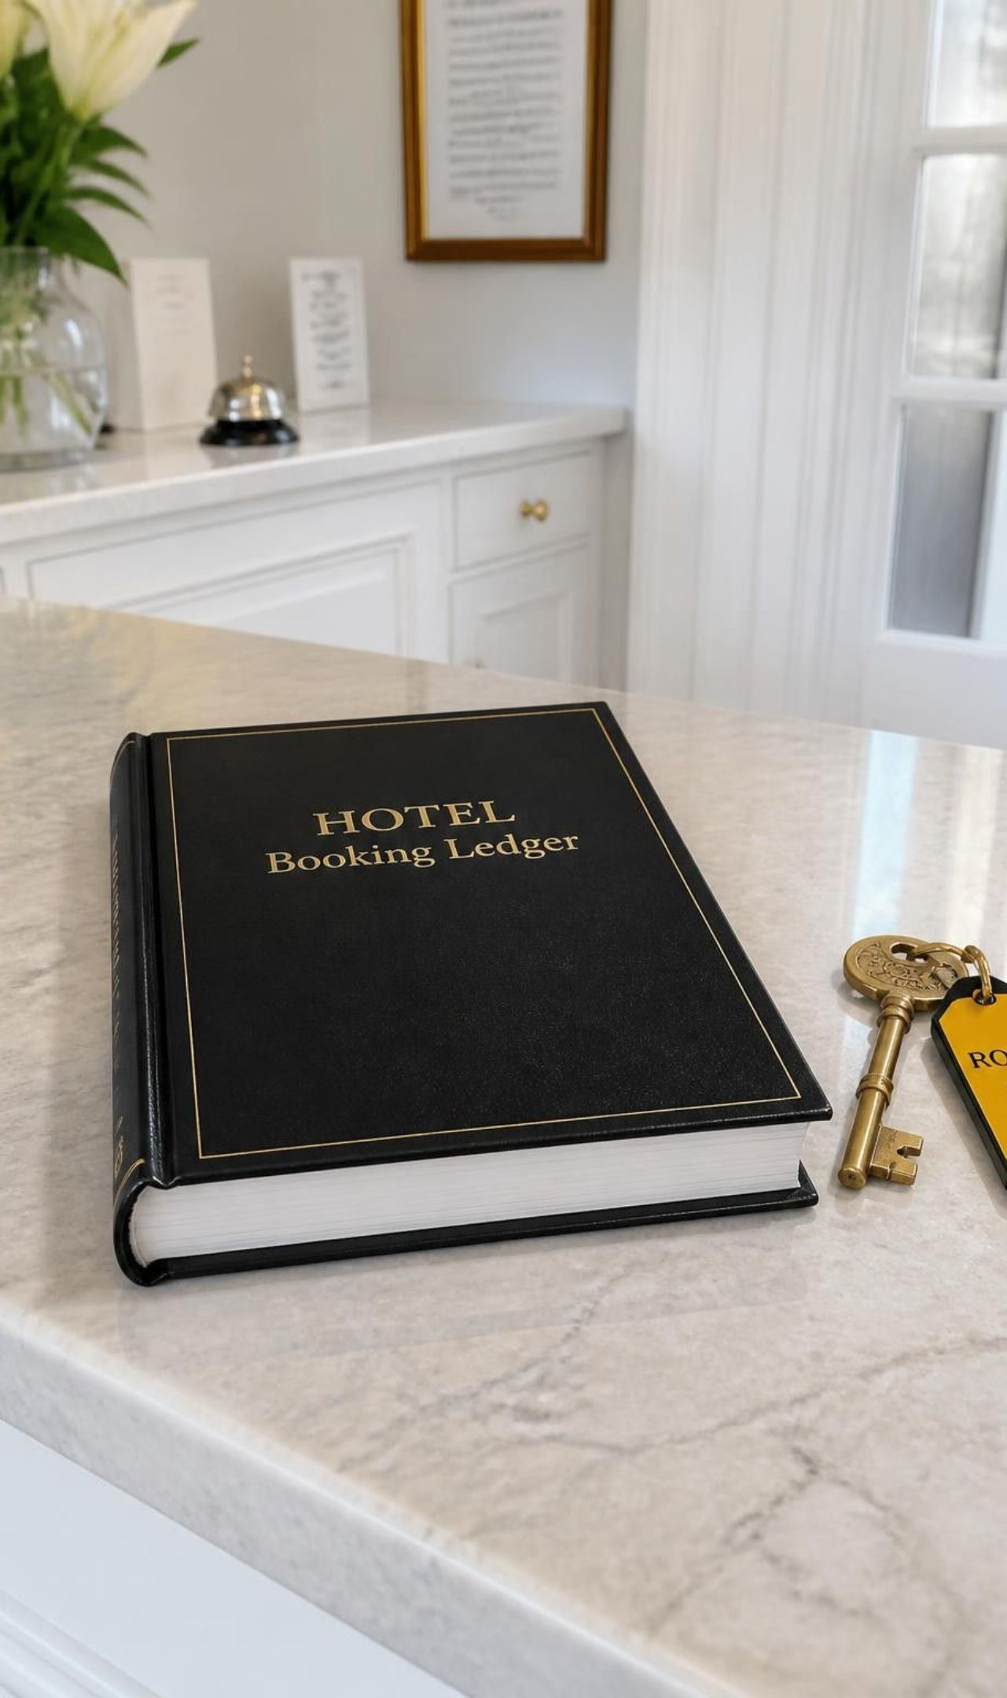
16 · CONCLUSION
16 · Conclusion
The Hotel Booking & Occupancy Manager shows how Java foundations can combine into a practical hotel booking application.
Applied concepts
Java foundations, control flow, methods, arrays, recursion, and matrix operations
Takeaway
A structured program can turn booking rules and occupancy data into clear, reusable results
Thank You
Project Members: Bharadwaj & Mukesh

